Slide 1
Honeywell Chemical Manufacturing Optimisation

Slide 2
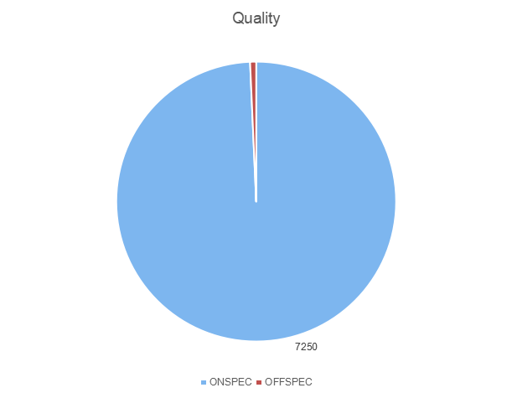
Statement of Problem
Total Number of Batches = 7250
Number of OFFSPEC=51
Odds of OFFSPEC = 1 in 142

Slide 3
Important Relationships
Quality f(OFFSPEC)
OFFSPEC f(ABD)
ABD f(Al.Cl.Sol.PV)
Al.Cl.Sol.PV f(Al.Cl.Sol.SP)

Slide 4
Introduction to Regression
Y = α+β1+β2+u
Y = dependent variable
α = Intercept
β1=Coefficient of 1st Independent variable
β2=Coefficient of 2nd Independent variable
u=error term

Slide 5
Econometric Example
W=α+XP+L+E+u
W=Wages
α = Intercept
XP=years of experience
L=Location
E=Education
u=error term
W=E(W)+2.1*xp+0.4*L+0.2*E+e

Slide 6
Statistical Tests
Corr(Al.Cl.Sol.PV,ABD) = 0.71
Corr(Al.Cl.Sol.PV,Al.Cl.Sol.SP) = ?
Reg(Al.Cl.Sol.PV,Al.Cl.Sol.SP)=β1
Reg(ABD,Al.Cl.Sol.PV)=β2
Reg(ABD~.)=?

Slide 7
Regressing PV on SP
Y=α+β1x
Y=Al.Cl.Sol.PV
α=Intercept
β1=Reg(Al.Cl.Sol.SP,Al.Cl.Sol.PV)
x=Al.Cl.Sol.SP
Al.Cl.Sol.PV=α+β1(Al.Cl.Sol.SP)+u

Slide 8
Regressing ABD on Al.Cl.Sol.PV value
Y=α+β2x
Y=ABD value
α=Intercept
β2=Reg(Al.Cl.Sol.PV,ABD)
ABD=α+β2(Al.Cl.Sol.PV)+e

Slide 9
Important Concepts to Consider
Is there is a linear relationship between ABD and Al.Cl.Sol.PV?
Is there is a time lagged relationship between Al.Cl.Sol.SP and Al.Cl.Sol.PV?
How many .PV are affected by change in a single .SP

